Slide 1

SHEild
I’m for your safety
I’M FOR YOUR SAFETY

Slide 2
PROBLEM STATEMENT :
Women harassments are basically general issues faced by many in our country.
Also while transporting Accidents are majorly occurring.
SOLUTION :
This device helps women to inform to her family and nearby
police stations that she is in danger just by Pressing an button.
Also when Axis of the vehicle changes it intimates that vehicle has met with an accident at so and so location.

Slide 3
DESCRIPTION OF SOLUTION:
Message transmitted
She gets some help.
Location is been tracked
To registered contacts
Press button

Slide 4
COMPONENTS REQUIRED:
ARDUINO NANO
GSM MODULE
GPS TRACKER
GYROMETER
BUTTON

Slide 5
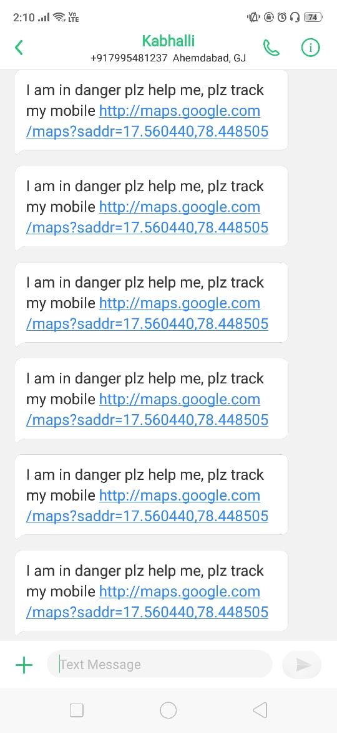
OUTPUT :

Slide 6
MARKETING STRATEGY :
Scooter manufacturer company are our customers.
64 Percent are preferring scooters.
We reach them through mouth advertising.
Spreading awareness to manufacture companies and letting them know about SHEild.

Slide 7
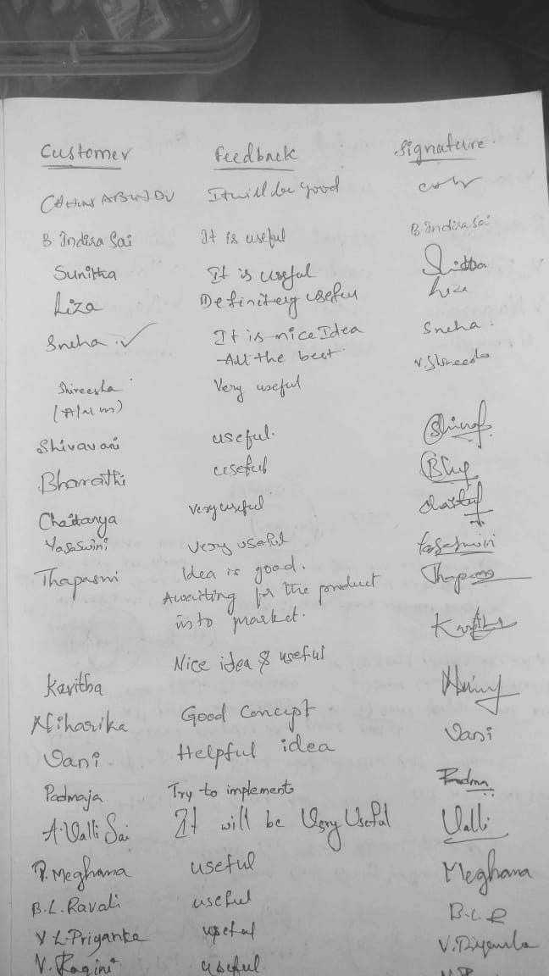
CUSTOMER FEEDBACK:

Slide 8
COMPETITORS :
Mobile applications , Smart bands , Electrical rods for women safety.
HOW WE DIFFERENT FROM THEM :
All other device will not useful while driving where as our device is Useful while driving.

Slide 9
FINANCIALS :
The estimated cost for building up our product is Rs.2500/-
Revenue for this model is cost of the product is Rs.5000/-

Slide 10
TEAM MEMBERS :
B.SREEJA
B.PRATHYUSHA
A N.CHANDANA
G.SOWMYA

Slide 11
Q&A

Slide 12
THANK YOU

